Slide 1
Cosmic rays at “Mercati di Traiano”
Liceo Cavour Roma
A.S 2022-2023
CREF- Extreme Energy Events

Slide 2
Topics
The Cosmic Rays
EEE Project
Cosmic rays detection
Application of cosmic rays detaction
Instrument for measuring the number of cosmic rays
How the cosmic box work
Measurament at Mercati di Traiano
Results

Slide 3
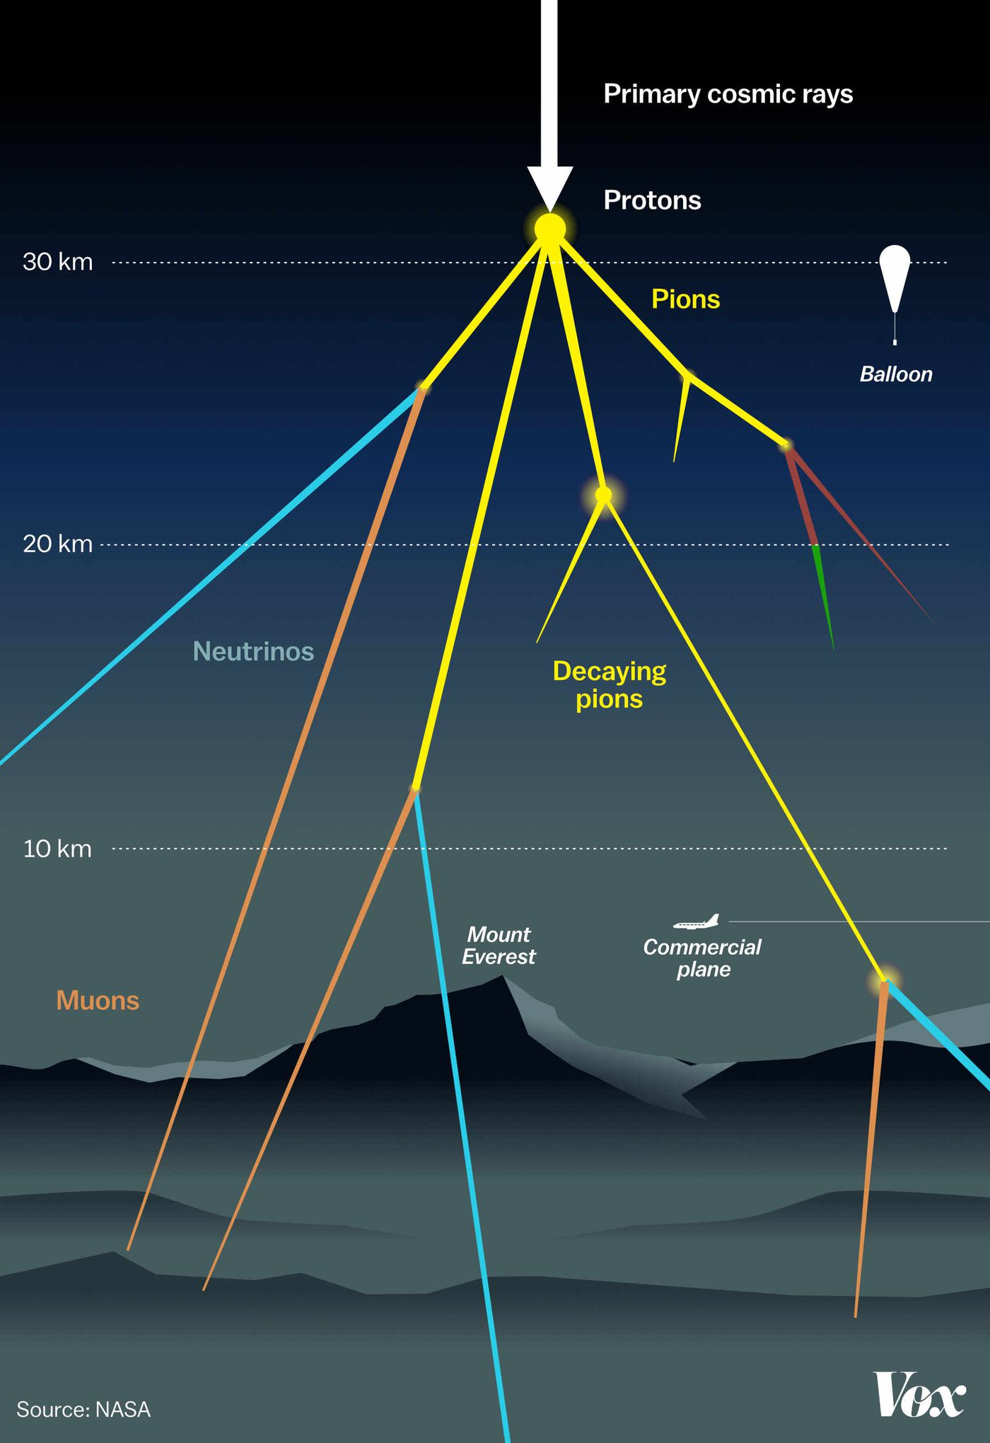
The Cosmic Rays
Cosmic rays, also called Astro particles, are subatomic particles of medium or high energy that impact the Earth every day. They are the product of the interaction of primary cosmic rays with the Earth's atmosphere.
The impact produces a swarm of particles (the secondary rays ) of different types that can be detected with special instruments that take advantage of the properties of cosmic rays to interact with matter, for example, by causing the ionization of a gas, as in the detector chambers of the Extreme Energy Events (EEE) project, or by exciting the production of photons, as in the scintillation chambers of the Cosmic Box.
One of the fundamental properties of cosmic rays is the variation of their flux with altitude, a feature that has led in the past to the identification of the same cosmic rays as extraterrestrial radiation.

Slide 4
EEE (Extreme Energy Events) Project
The EEE project (Extreme Energy Events) is a research project of the:
CREF (Centro Ricerche Enrico Fermi) in collaboration with:
CERN (Conseil Européen pour la Recherche Nucléaire - European
Nuclear Research Council),
INFN (Istituto di Fisica Nucleare - National Institute for
Nuclear Physics)
MIUR (Ministero dell'Istruzione, Universita' e Ricerca - Ministry of Education, Universities and Research) This project is carried out in collaboration with the schools, which house a detector for the identification and study of cosmic rays. The detector is built by the students at CERN and is managed and maintained by them with the help of the teachers in the school. The data collected by the detector is then sent in real time to the CNAF (Centro Nazionale Analisi Fotogrammi - National Center for Image Analysis) in Bologna and to the INFN computer center. Students can use the data for practice purposes, always under the control of the Enrico Fermi Center, which organizes regular running meetings. The schools that don't have the detector nevertheless perform data analyses.

Slide 5
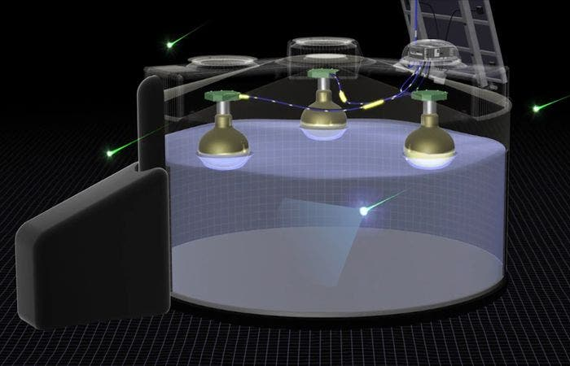
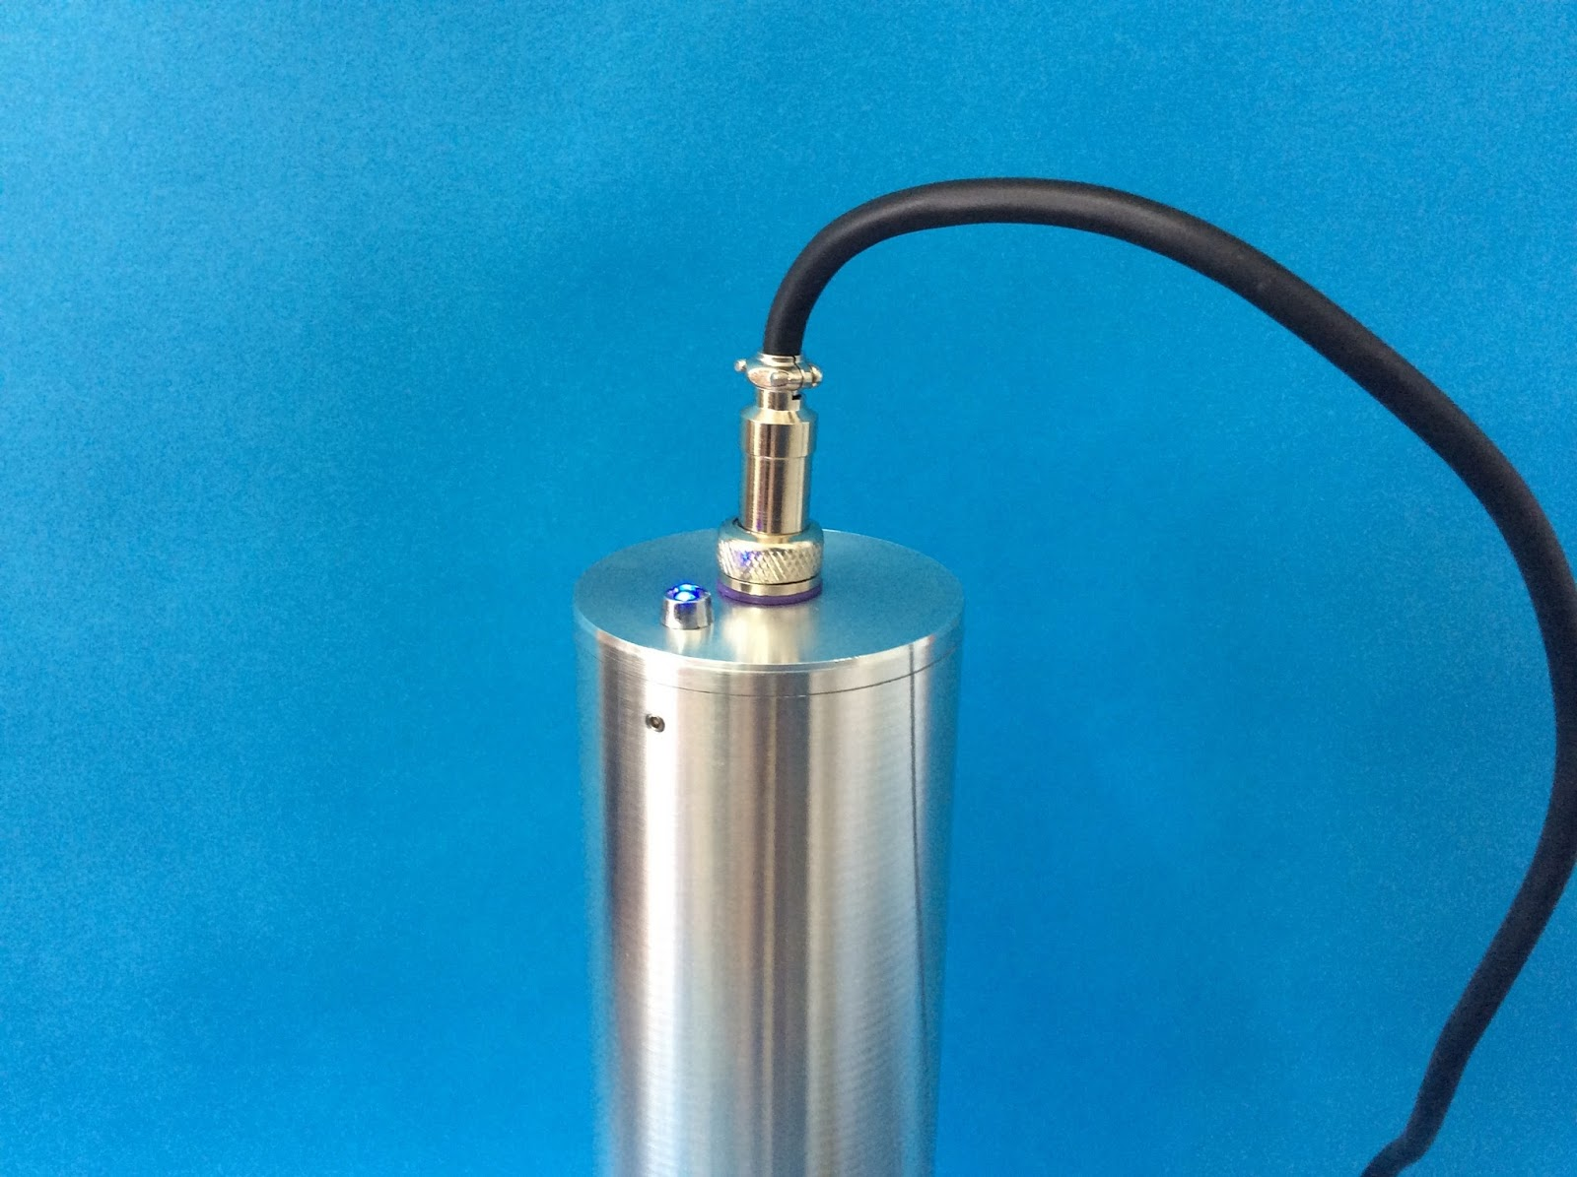
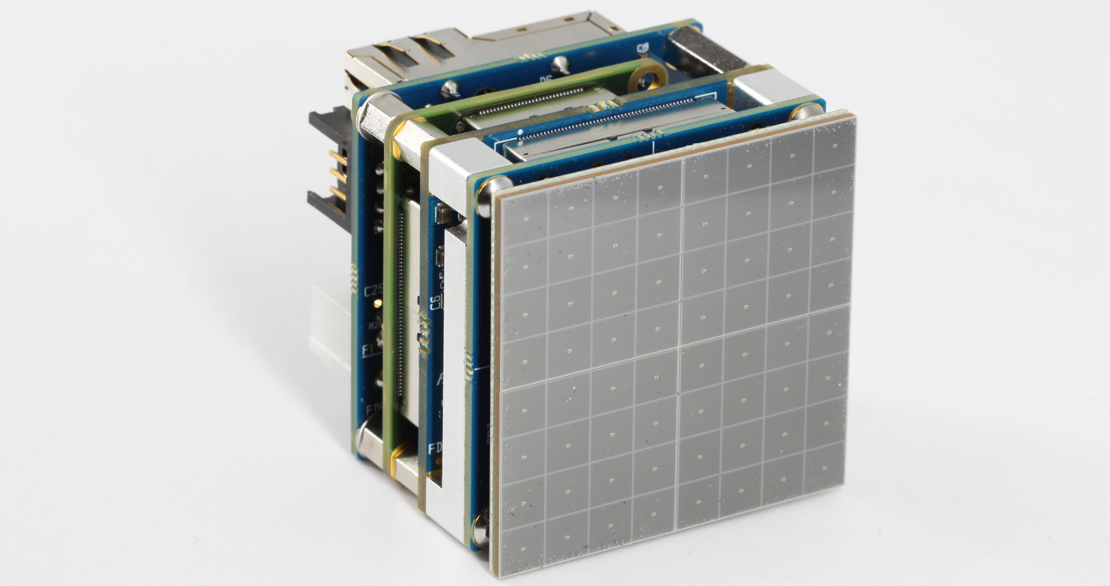
Cosmic rays detection
Cosmic rays are the product of the interaction of primary cosmic radiation with the Earth’s atmosphere.
The impact produces a swarm of particles of different species that can be detected through the use of special tools that exploit the properties of cosmic radiation to interact with matter.
Cherenkov detectors Scintillation detectors Gamma ray detectors

Slide 6
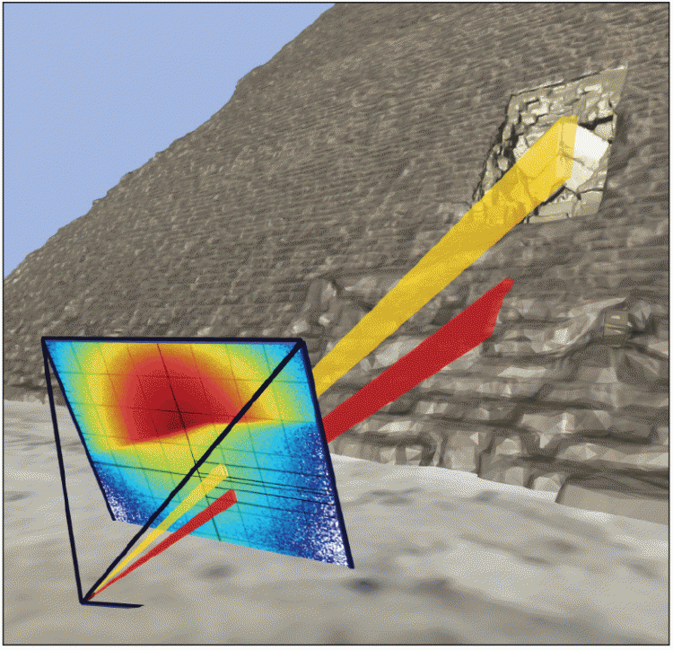
Application of cosmic rays detection
The detection of cosmic rays has several important applications in scientific research.
Understanding the origin and nature of cosmic rays, which provides valuable clues to the formation of stars, galaxies, and high-energy cosmic objects.
Identifying the different types of cosmic particles, distinguishing between protons, electrons, positrons, and atomic nuclei.
Providing information on the spectral distribution and the amount of energy transferred by cosmic particles.
Observing the universe using cosmic rays to study high-energy astrophysical phenomena such as gamma-ray bursts, supernovae, black holes, and active galaxies.
- Study the composition of cosmic rays to understand particle interactions in interstellar
space and the properties of the early universe.
Cosmic ray detection plays a critical role in unraveling the mysteries of the universe. A variety of detection methods allow scientists to study high-energy charged particles from space. These discoveries have multiple applications, including determining the origin, energy, and composition of cosmic rays and exploring high-energy astrophysical phenomena. Advances in detection technology are helping to expand our understanding of the universe and the fundamental processes that govern it.

Slide 7
Instrument for measuring the number of cosmic rays
Detectors are instruments used to detect, track, and identify particles from cosmic rays, nuclear decay, and interaction processes in accelerators.
Cosmic rays with high energy are detected with experiments performed mainly on the Earth's surface.
The detector used in the EEE project consists of three chambers through which the cosmic rays are detected. Measurements include the length of the track, the time of flight, and the number of tracks detected. The measurement station also provides all the environmental parameters of the place where the detector is located, as these can influence the data and in some cases cause the instrument to malfunction, for example in the case of very high temperature.
Photomultiplier
A photomultiplier is a device that converts incident photons into an electrical signal.
Kinds of photomultiplier include:
* Photomultiplier tube, a vacuum tube converting incident photons into an electric signal.
* Magnetic photomultiplier developed by the Soviets in the 1930s.
* Electrostatic photomultiplier, a kind of photomultiplier tube demonstrated by Jan Rajchman of RCA Laboratories in Princeton, NJ in the late 1930s which became the standard for all future commercial photomultipliers.
* Silicon photomultiplier, a solid state device converting incident photons into an electric signal.
Scintillators
A scintillator is a material that exhibits scintillation, the property of luminescence, when excited by ionizing radiation. Luminescent materials, when struck by an incoming particle, absorb its energy and scintillate.
Sometimes, the excited state is metastable, so the relaxation back down from the excited state to lower states is delayed (necessitating anywhere from a few nanoseconds to hours depending on the material). The process then corresponds to one of two phenomena: delayed fluorescence or phosphorescence.
By coupling a scintillator to a photomultiplier, an electrical signal is obtained proportional to the amount of light received. This gives an estimate of the number of charged particles that have passed through the detector.

Slide 8
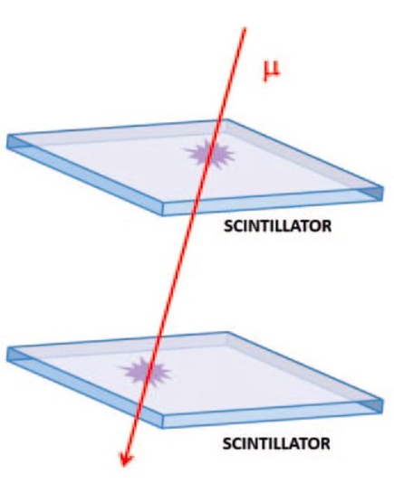
The cosmic box
The cosmic box is an instrument that consists of two plates of scintillator material, placed parallel to each other at about 30 cm. When a charged particle passes, it releases energy that is then converted into photons. The photons are detected by a photosensor that converts them into electrical signals.
In order to avoid capturing spurious events, the Cosmic Box can record the data only when a charged particle is captured by both scintillators: when the Cosmic Box works in this mode, it can only select reliable events within a certain solid angle and show the obtained data on its display. The larger the distance between the two scintillators, the smaller the number of particles detected by the Cosmic Box, since they are contained within a smaller solid angle.

Slide 9
Measurements at Mercati di Traiano
The "Mercati di Traiano" is a complex of buildings built mainly during the reign of Trajan (98-117 CE) in the Roman Fora on the Quirinal Hill. The complex was part of Trajan's Forum and served mainly as commercial and residential buildings.
The entire complex was built using the "opus latericium" construction technique, which consisted of building a concrete structure and covering it with tiles. In this way, the builders and the architect (probably Apollodorus of Damascus) were able to fill every available space on the slope.
Trajan's markets were probably built for commercial purposes, as Emperor Trajan wanted to avoid a shortage of food. Therefore, the "tabernae" and alcoves served to supply the Romans with goods. However, historians doubt the actual purpose of the markets and believe that they also served as places for administrative activities.
Over the years, the complex has undergone various changes. In the Middle Ages, noble families began to build defensive towers and elements next to it. In the 16th century it was transformed into a monastery and then into barracks. Finally, in the 20th century it was recognised as an archaeological site and today it is part of the Museum of the Imperial Forums.

Slide 10
Measurements
Five series of measurements were collected.
The data of series 0 and series 1 were collected on the first floor of the archaeological site: series 0 in the open air and series 1 in one of the niches on the first floor.
Series 2 and 3 data were collected on the second floor: series 2 partially outdoors in one of the openings of the building, and series 3 by placing the Cosmic Box in one of the rooms on the second floor.
The data of series 4 were collected outdoors, on the roof of the monumental complex.
Tab. 1 shows the counts recorded every two minutes on the various floor of the building and the environmental parameters (pressure P, temperature T and relative humidity U) related with each series.
Tab. 1

Slide 11
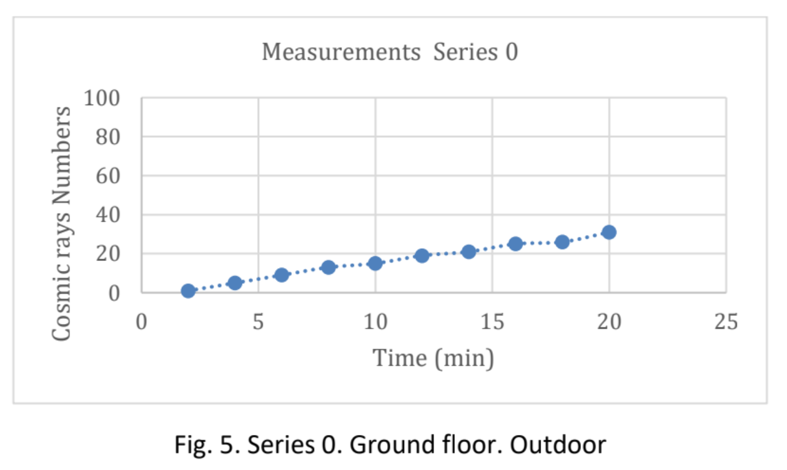
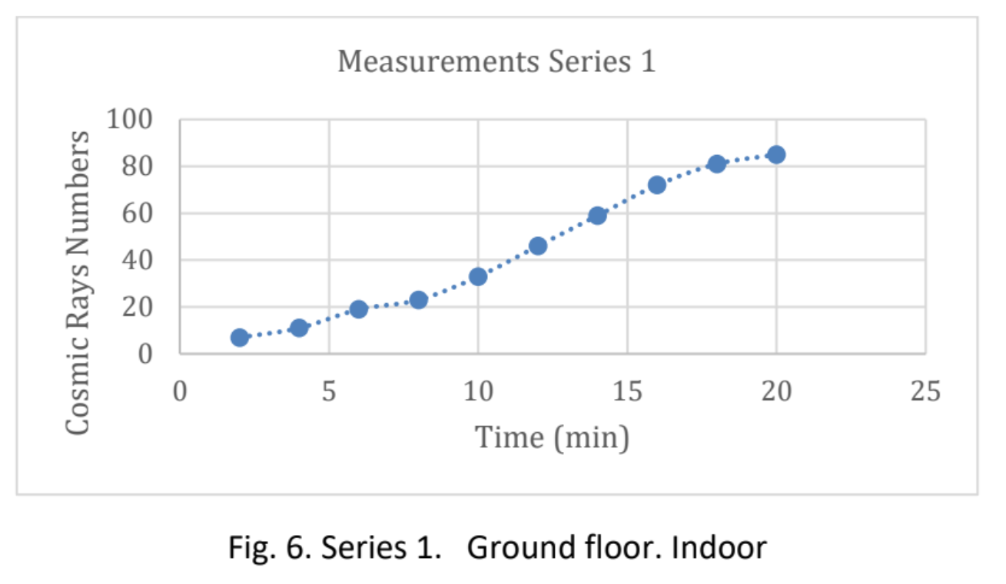
Data collection 0 and 1

Slide 12
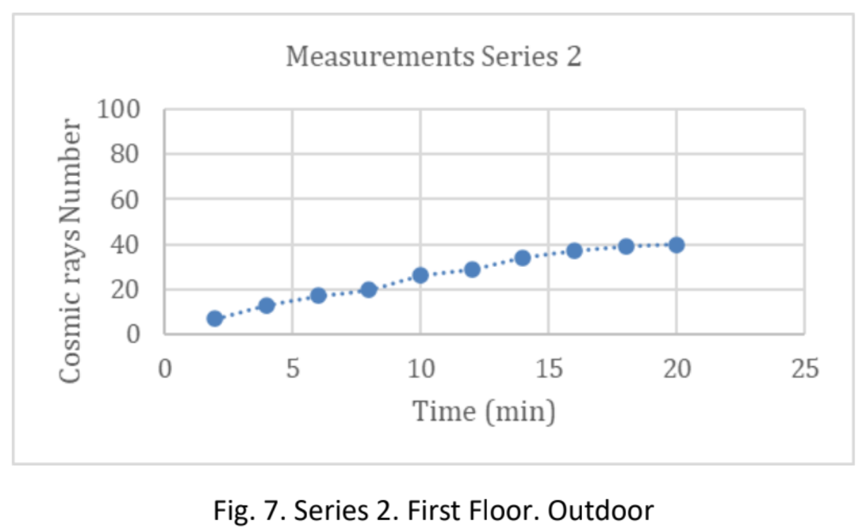
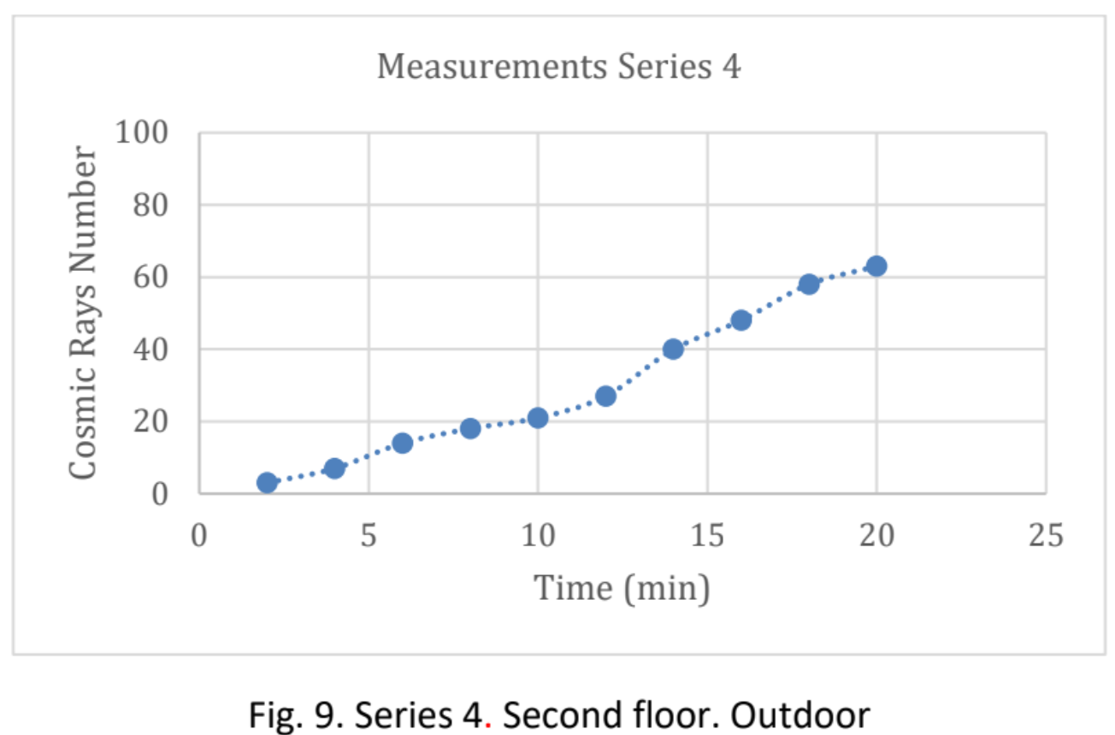
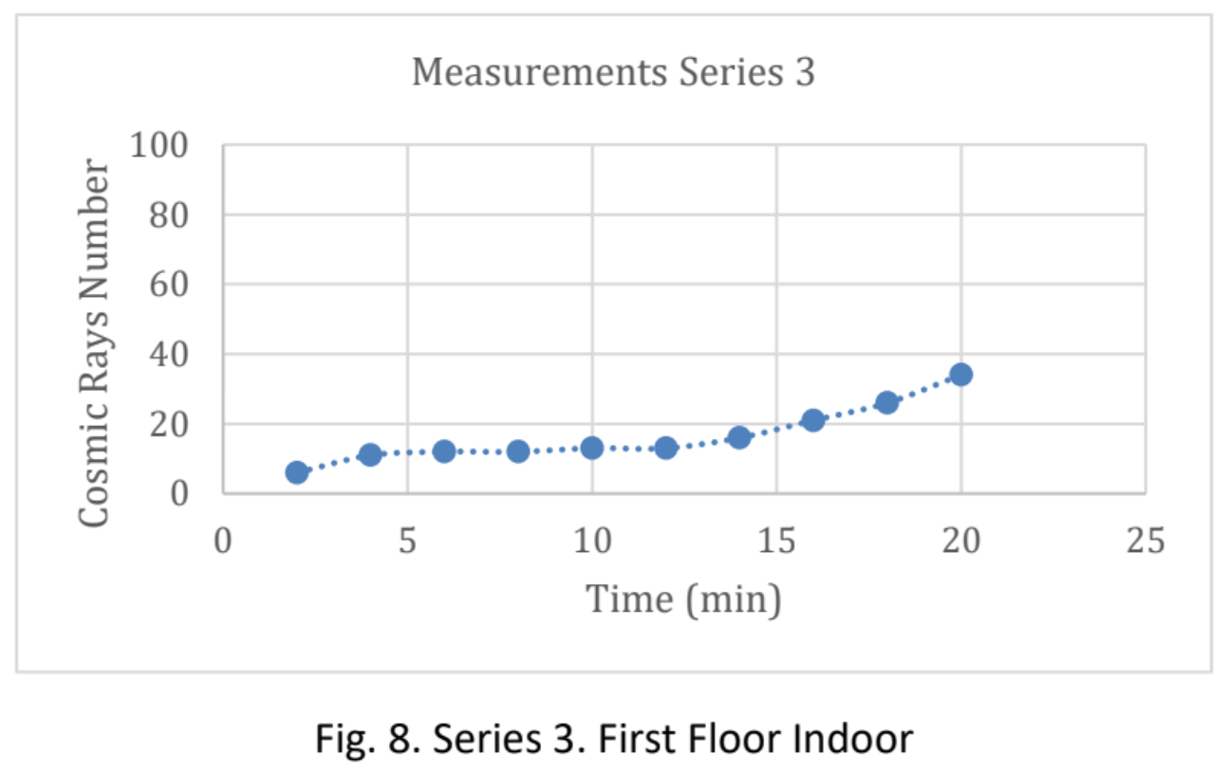
Data collection 2-4

Slide 13
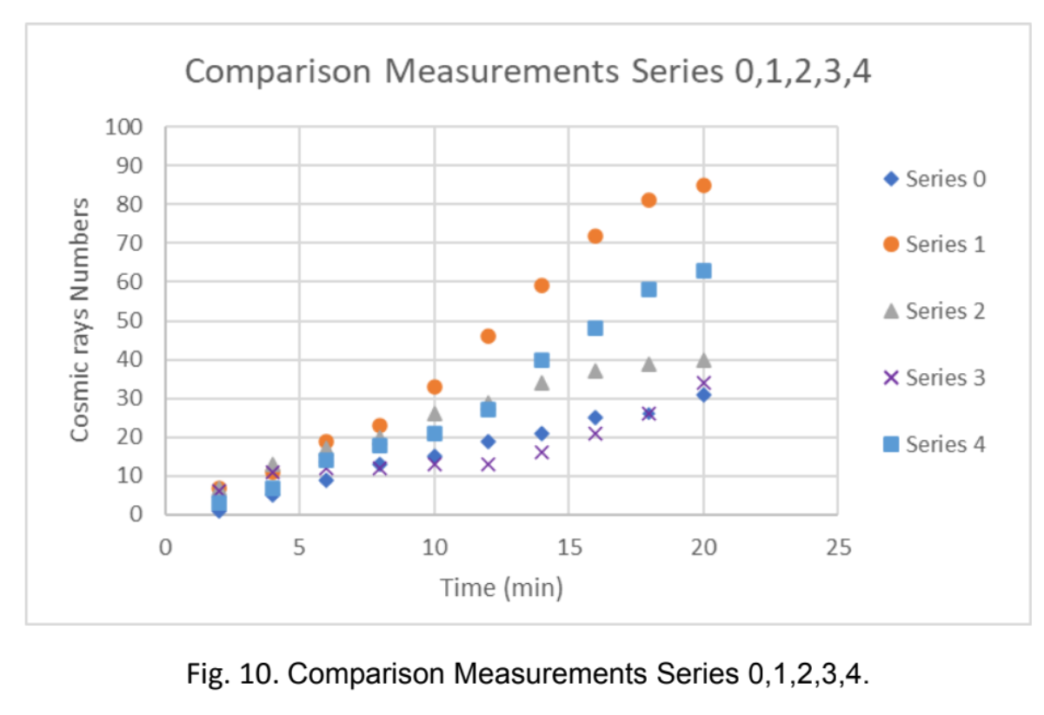
Measurements analysis and comparison
The graphs show that the number of cosmic rays is proportional to time, with a linear proportionality.
In graph 1, the maximum value of the y-axis is 31. This value is the maximum number of cosmic rays detected in the open air, on the first floor.
On the other hand, the maximum value of graph 2 (which represents the number of cosmic rays detected indoors, on the first floor) is 85. This result was not expected, since it was assumed that the maximum value of rays reaching the ground outdoors would be greater than the maximum value of rays detected indoors. The same can be seen in Fig. 7 and Fig. 8, which show the number of rays detected outdoors and indoors, respectively, on the first floor of the market.

Slide 14
Further comparisons

Slide 15
Conclusions
The measurement campaign confirms the theory about the linear proportionality between the number of cosmic rays and height.
The measurements are carried out both outdoors and under the arch of the "Mercati di Traiano". For each level of the building, both outdoors and indoors measurements are recorded. The outdoor measurements (Fig. 11) confirm the usual increase of cosmic rays with increasing altitude.
Nevertheless, a greater number of cosmic rays are detected in the indoor measurements than in the outdoor ones (Fig. 6) at the first level of the building. We suspect that this is probably due to the material, since the ancient Roman monuments are made of tuff, a radioactive rock (it emits radon) and the vault, under which the box was located, was composed of tuff. In the second indoor measurements at the second level of the building, the increase in the number of rays is not as relevant as in the first level of the building. It is probably due to the material from which the room was built that apparently shields the rays.

